Slide 1
Proposal Evaluation
EN2533
Robot Design and Competition
Group – 03
Helios

Slide 2
Typical Robotic System
Body Structure
Power Source
Sensors
Brain (Micro controller)
Actuators

Slide 3
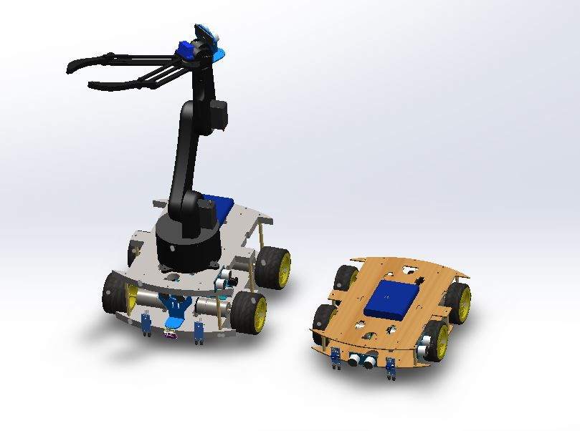
Body Structure

Slide 4
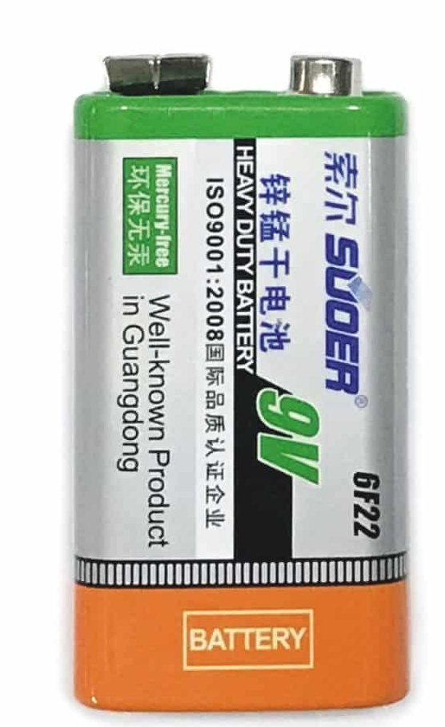

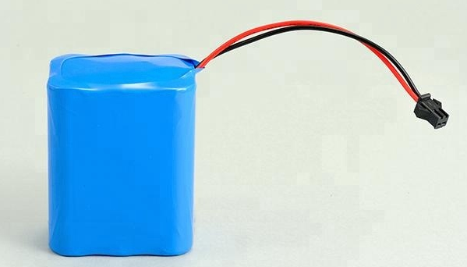
Power sources

Slide 5
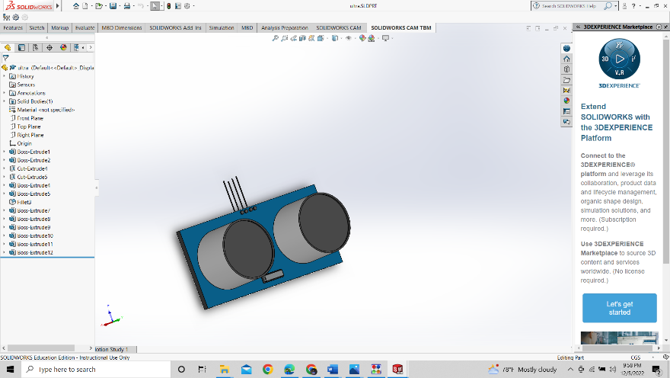
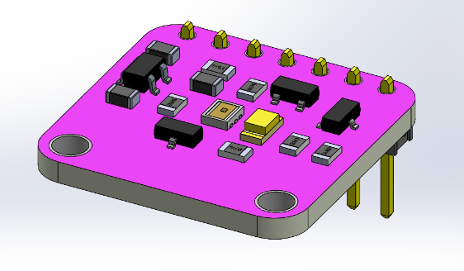
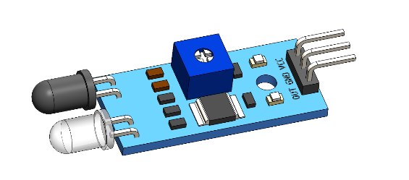
Sensors

Slide 6
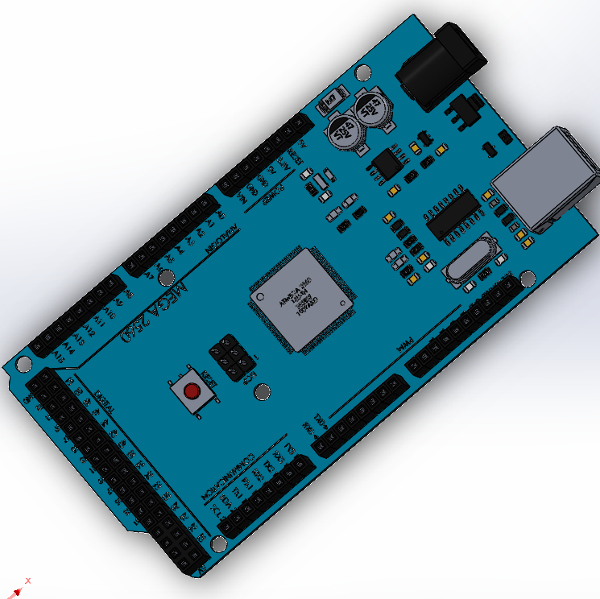
Brain

Slide 7
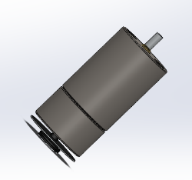
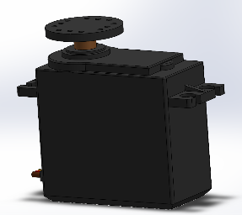
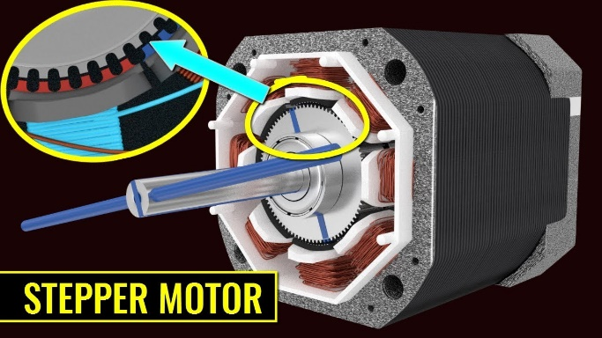
Actuators

Slide 8
Physical Task
EN2533
Robot Design and Competition
Group – 03
Helios

Slide 9
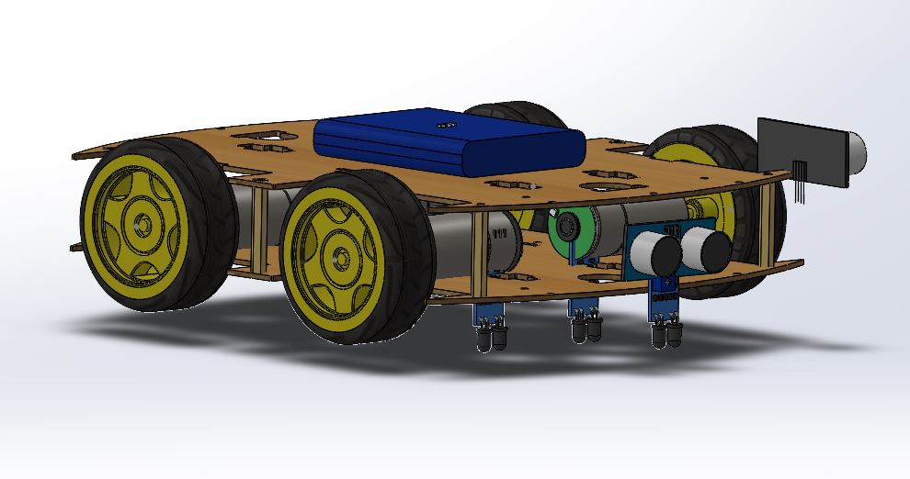
Body structure
19cm
24cm

Slide 10
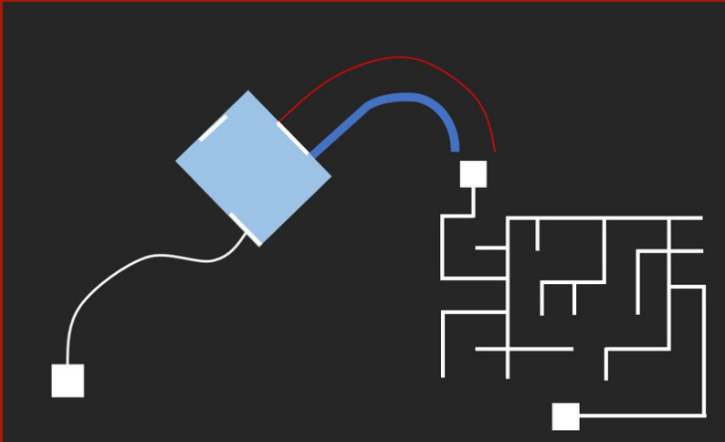
Navigation

Slide 11
Online Simulation
EN2533
Robot Design and Competition
Group – 03
Helios

Slide 12
Body structure

Slide 13
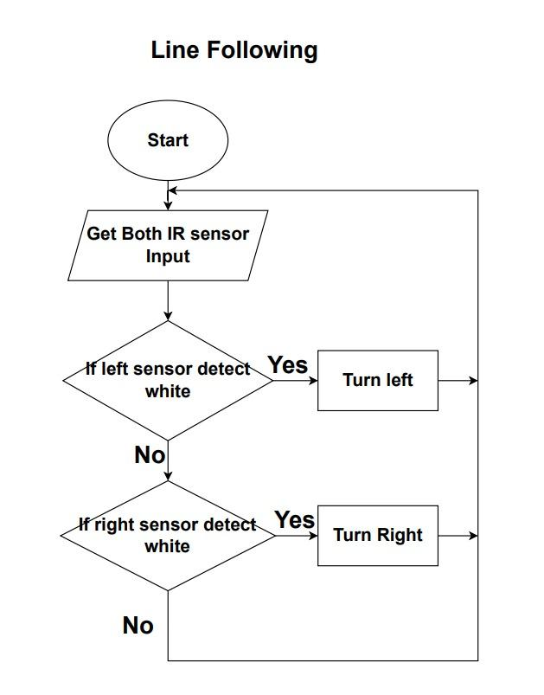

Slide 14
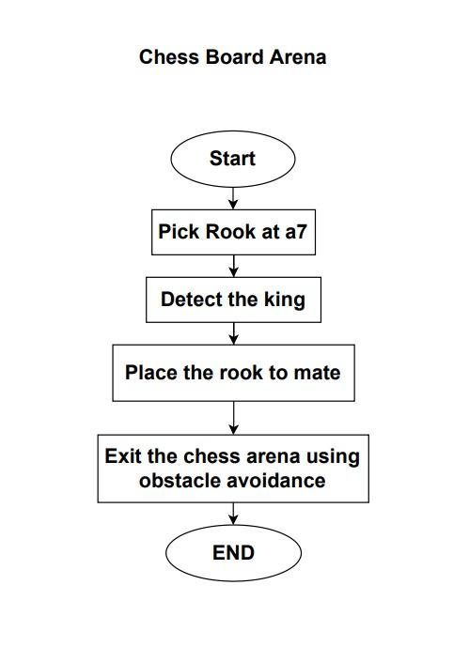

Slide 15
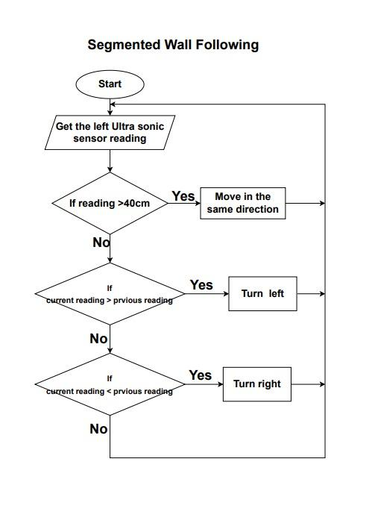

Slide 16
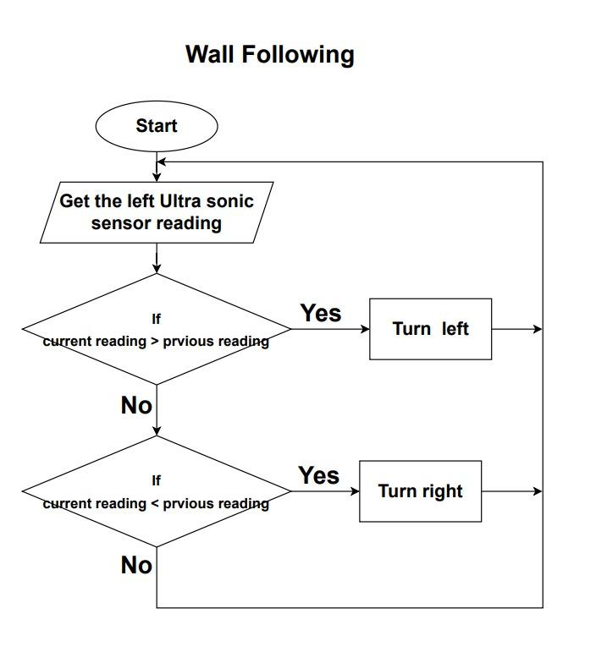

Slide 17
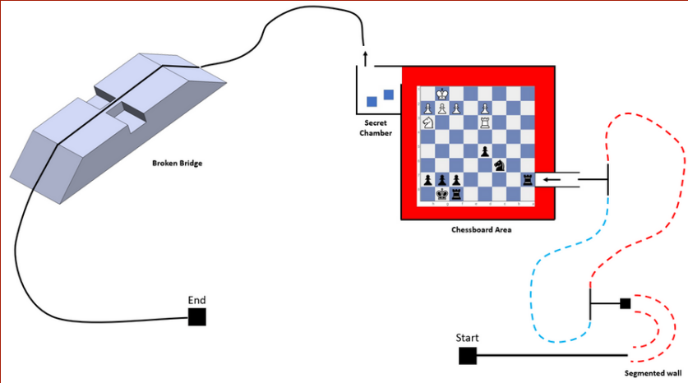
Navigation

Slide 18
Q & A
EN2533
Robot Design and Competition
Group – 03
Helios

